Slide 1
TOPIC ON:
FINGER-VEIN RECOGNITION
PRESENTED
BY
OKPARA KENNETH CHINONSO
2017/HND/CST/76849

Slide 2
INTRODUCTION
Biometrics is the measurement and recording of the physical characteristics of an individual for use in subsequent personal identification.
Finger vein recognition is a method of biometric authentication that uses pattern-recognition techniques based on images of human finger vein patterns beneath the skin's surface.
Finger vein recognition is one of many forms of biometrics used to identify individuals and verify their identity.

Slide 3
INTRODUCTION conts..
This process is largely considered to be safer than fingerprint recognition, as it cannot be replicated or fooled since the pattern is hidden from view. Finger vein recognition is also known as vein matching or vascular technology.
It is a fairly recent technological advance in the field of biometrics that is being applied to different fields such as medical, financial, law enforcement facilities and other applications where high levels of security or privacy is very important.

Slide 4
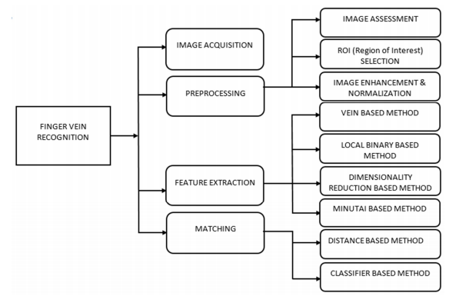
IMAGES AND DIAGRAMS

Slide 5
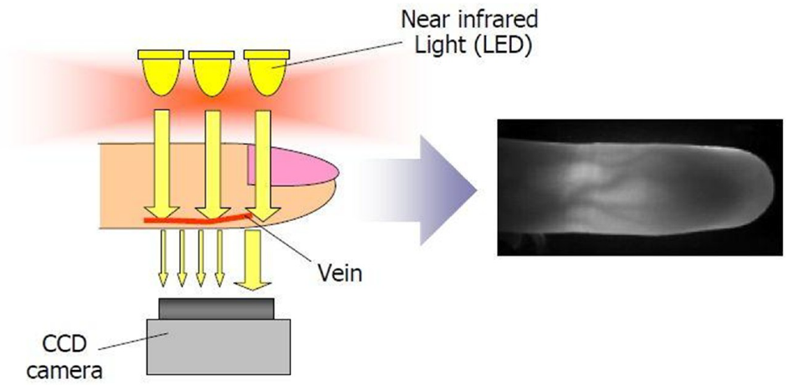
HOW A FINGER VEIN SCANNER WORKS

Slide 6
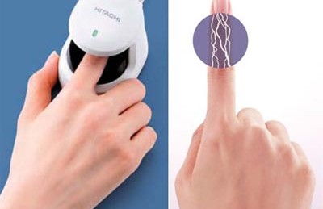
FINGER-VEIN SCANNER

Slide 7
BENEFITS
Finger vein patterns are unique to each individual, even among identical twins.
Finger veins are less likely to be influenced by changes in the weather or physical condition of the individual.
Finger veins do not leave any trace during the authentication process and so cannot be duplicated.

Slide 8
BENEFITS conts..
Because veins are located inside the body, it is extremely difficult to read or steal. There is little risk of forgery or theft.
Finger vein patterns remain relatively constant through the adult years so that re-enrollment of the vein pattern will not be required once enrolled.
Rushes, cracked and rough skin do not affect the result of authentication.

Slide 9
SUMMARY
Biometric system is very useful as it employs biology features of an individual. Finger vein features are one of the good biological characteristic that is stable and distinct for everybody. Thus, it can ensure a higher security of the developed system. Compare to other biological traits such as finger mark, finger vein provides more advantages in terms of their uniqueness. Therefore, it strictly disallows frauds and intruders into its system. Finger vein verification verifies an individual’s finger vein by comparing and matching the person’s finger vein with the stored templates.

Slide 10
CONCLUSION
Finger-vein based identification technology has high security and reliability compared to the traditional authentication mode. It also can be applied in public or private equipments, such as entrance control systems, home or office door entry control systems, and ATM (Automated Teller Machine) systems.

Slide 11

VIDEO: HOW FINGER VEIN WORKS

